Slide 1
Web Application For Product Return Management
PIP104 PROFESSIONAL PRACTICE-II
VIVA-VOCE
Batch Number: CAI-G38
Under the Supervision of,
Dr. Mohammadi Akheela Khanum Professor School of Computer Science and Engineering,Presidency University
Roll Number | Student Name
20201CAI0022 | Arikeri Praveen
20201CAI0051 | B Mohan Reddy
20201CAI0076 | Katta Uday Kiran Reddy
20201CAI0218 | Addagalla Koushikeswar

Slide 2
Introduction
Problem Statement :
In case of excess supply, wrong/damaged deliveries to end customers, SKF customer service team returns the product back to the regional warehouse irrespective of the condition of material. Hence, sometimes we (India Distribution Centre) end up receiving damaged stocks even after an ok Proof of Delivery which results in blocked stocks and we end up scrapping them leading to loss. A solution can be developed that a proper justification for return is mentioned and the right decision on return of goods is taken

Slide 3
Literature Review
From [1] the author has discussed the problem faced by the service team while returning the product. He came with some set of criteria such as proper justifications for returns, return policies, etc.
From [2] a study of Impact of Damaged Goods Returns on the Supply Chain, the authors identify a number of ways that companies can minimize the impact of damaged goods returns, such as:
implementing a strict quality control process, improving packaging and shipping procedures.
From [3] The Impact of Customer Satisfaction on Damaged Goods Returns by Brown and Green (2021). This study found that customer satisfaction is a significant predictor of damaged goods returns. The study also found that businesses can reduce damaged goods returns by improving customer satisfaction. The study identified a number of strategies for improving customer satisfaction, such as providing high-quality products, offering excellent customer service, and making it easy for customers to return products.

Slide 4
Research Gaps Identified
1. Optimizing Product Return Management Systems in Supply Chains.
• Research Gap: Limited research on the long-term effects and flexibility of automated returns management systems in dynamically changing supply chain conditions.
2. Customer-Centered approaches to product return programs.
• Research Gaps: Insufficient research is done on the cultural and demographic influences on customer preferences across industries, leading to gaps in understanding how to tailor returns to different customer needs.
3. Technological Solutions for Restoration Management: A Comparative Analysis.
• Research gap: Lack of comprehensive studies assessing the environmental sustainability aspects of different technological solutions in return management systems, including their carbon footprint and overall ecological impact.

Slide 5
Research Gaps Identified
4. Decision-Making Algorithms in Restoration Management Systems.
• Research gap: limited research on flexible decision-making processes, especially how effective they are at managing profitability at scale during periods of maturity or volatile market conditions.
5. Design Impact of User Interaction on Return Scheduling.
• Research gap: Inadequate investigation into the accessibility and inclusivity aspects of user interface designs, with a need to explore how diverse user demographics, including those with disabilities, interact with and benefit from these designs.
• Identifying and addressing these research gaps can significantly contribute to refining and improving the regression management process, ensuring its effectiveness, sustainability, and deployment in different contexts.

Slide 6
Proposed Methodology
User and Employee Authentication
Data Storage: MySQL Database
User Interface Design
Data Submission
Backend Development: Java Full Stack with Servlet Programming
Employee Access to User Responses
Decision-Making Algorithm: Product Routing Logic
Minimizing Losses
IDE and Project Setup: Eclipse for Enterprise

Slide 7
Objectives
Establish Precise Justification for Returns
Implement Decision-Making Process
Minimize Damaged Stocks at India Distribution Centre
Optimize Inventory Management
Decrease Scrap Material and Associated Losses
Enhance User and Employee Interaction
Implement Robust Security Measures
Utilize Java Full Stack for Dynamic Web Pages
Provide Real-time Decision Support

Slide 8
System Design & Implementation
The system design and implementation for the described context involve creating a web application with user-friendly interfaces, secure data handling, and efficient decision-making processes. Below is an outline of the key components and steps involved in the design and implementation:
1. Frontend Design (HTML, CSS, JavaScript):
• Home Page:
o Includes buttons for user and employee login.
• User Login Page:
o Form for user login with redirection to the return management page.
• Employee Login Page:
o Form for employee login with access to user responses.
• Return Management Page:
o Form to collect user responses related to the product condition.
o Utilize JavaScript for pop-up messages and enhanced user interaction.

Slide 9
System Design & Implementation
2.Backend Design (Java Full Stack with Servlets):
Servlets:
Develop Java servlets for dynamic web pages, handling requests, and generating responses.
Implement servlets for user login, employee login, and data submission.
3.Database Design (MYSQL):
USER TABLE:
Username
Password
DATA Table:
EntryID (Primary Key)
UserID (Foreign Key referencing USER.UserID)
ProductID
ProductCondition
Feedback
ReasonForReturn
EMPLOYEE Table:
Username
Password

Slide 10
System Design & Implementation
Connectivity and Dependency Management:
Java Full Stack Setup:
Import servlet API and MYSQL Connector jar files into the project dependencies.
Utilize Eclipse for Enterprise IDE for Java Full Stack development.
User and Employee Interaction:
User Login:
Capture user login details and store them in the USER table.
Redirect users to the return management page after login.
Employee Login:
Capture employee login details and validate against the EMPLOYEE table.
Provide access to user responses through dynamic tables on the employee portal.
Data Submission and Storage:
Return Management Page:
Collect product condition data from users (product ID, condition, feedback, reason for return).
Submit data to the DATA table in the MYSQL database.

Slide 11
System Design & Implementation
7.Decision-Making Algorithm:
Algorithm Implementation:
Assess the collected data in the DATA table to determine whether the product should be directed to the normal/undamaged warehouse or the damaged warehouse.
Update the Warehouse Selection attribute accordingly.
8.Security Measures:
Secure Coding Practices:
Implement secure coding practices to protect user data.
Regularly update and maintain security protocols to ensure data integrity.
Real-time Decision Support:
Real-time Warehouse Selection:
Enable real-time decision support for employees to quickly and accurately select the appropriate warehouse based on the product condition.
Scalability and Adaptability:
Flexible Architecture:
Design the system architecture to be scalable, accommodating future enhancements and adaptations.
Ensure flexibility to incorporate changes in technology and operational processes.

Slide 12
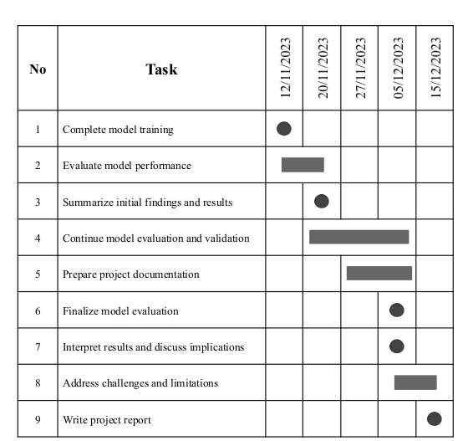
Timeline of Project

Slide 13
Outcomes / Results Obtained
Reduced Accumulation of Blocked Stocks:
The implementation of the web application has resulted in a significant reduction in
the accumulation of blocked stocks at the India Distribution Centre. By incorporating a thorough justification process, the likelihood of unwarranted returns has decreased.
Minimized Losses from Damaged Stocks:
The decision-making algorithm, fueled by user-submitted data, has effectively
guided the routing of products to the appropriate warehouse. This has led to a reduction in losses incurred from damaged stocks, preventing unnecessary scrap material.
Improved Decision-Making Process:
The web application's decision-making process, driven by real-time user responses,
has streamlined the identification of the product's condition. Employees can now make informed decisions on whether to direct the product to the normal/undamaged warehouse or the damaged warehouse.

Slide 14
Conclusion
In conclusion, the developed web application serves as an effective solution for addressing the challenges faced by SKF's customer service team in handling product returns.
The application seamlessly integrates HTML, CSS, JavaScript, Java Full Stack with servlet programming, and MySQL to create a comprehensive system that ensures proper justification for returns and facilitates an informed decision-making process.
The application promotes transparency, data-driven decision-making, and minimizes losses by ensuring that returned products are directed to the appropriate warehouse based on their condition

Slide 15
References
[1]. Priya Ambilkar, Vishwas Dohale and Angappa Gunasekaran (2021) “Product returns management: a comprehensive review and future research agenda”-Journal of Tandfonline.
[2]. G Walsh, C Koot and M Schaarschmid (2014) “Preventive Product returns Management Systems-a Review and Model” - Journal of ResearchGate.
[3]. S Zailani, K Govindan and MR.Shaharudin (2017) “Product return management: Linking product returns, closed-loop supply chain activities and the effectiveness of the reverse supply chains” – Journal of Elsevier.
[4]. GP Dapiran and BH Kam (2017) “Value creation and appropriation in product returns management” – Journal of Logistics Management.
[5]. SK Srivastava and RK Srivastava (2006) “Managing product returns for reverse logistics” - Journal of Emerald.
[6]. DA Mollenkopf, E Rabinovich and TM Laseter (2007) “Managing internet product returns: a focus on effective service operations” - Journal of Wiley.
[7]. DS Rogers, DM Lambert and KL Croxton (2002) “The returns management process”- Journal of Ingentaconnect.

Slide 16
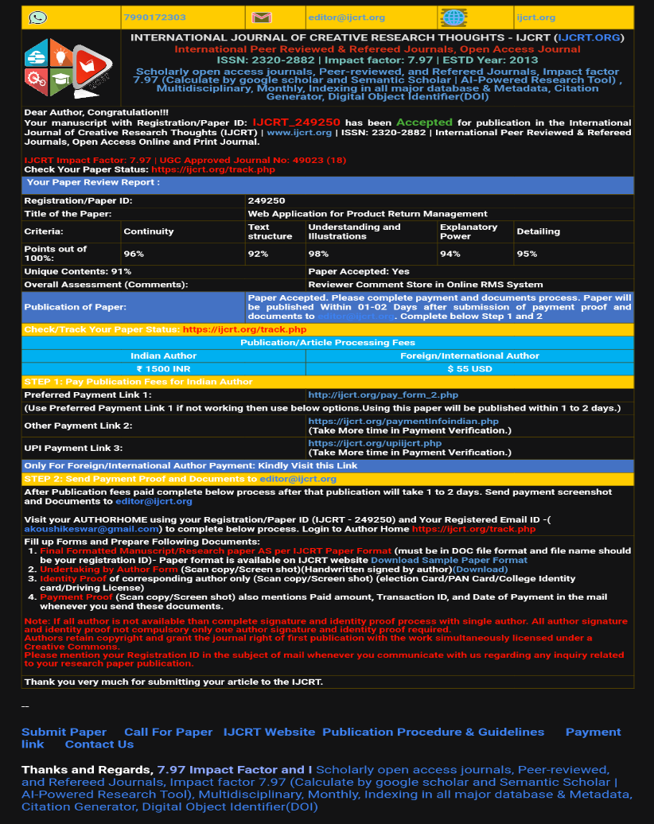
Publication Details

Slide 17

Thank You

